Slide 1

AIoT Service for News

Slide 2
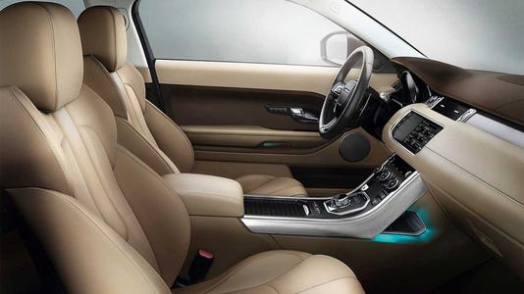
Scenario: In Car

Slide 3
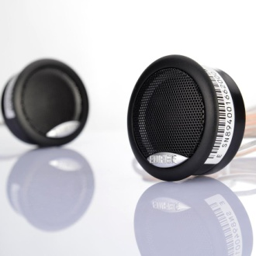
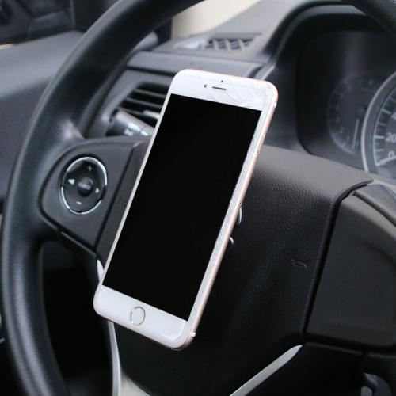
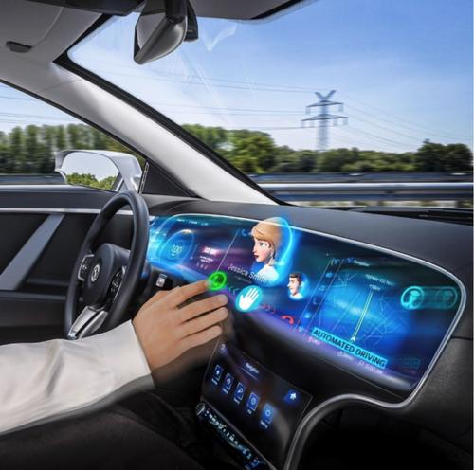
Devices
Car stereo
Smartphone/onboard touch screen
Functions
Basic functions
News-related functions
Volume self-adjustment
Auto-interruption
Input
Voice commands
Output
Audio news through car stereo
Visual contents through smartphone/onboard touch screen

Slide 4
 | Functions | Interaction
Basic Functions | Play/Pause | Say “Play”/”Pause”
 | Turn to the next news | Say “Next”
 | Volume adjustment | Say “Turn up”/”Turn down” – volume increases or decreases by 10％
News-related Functions | Like/Save to Collection | Say “Like” – after a warning tone, the current news will be added to collection
 | Change news genres | Say “Change to” + <a specific news genre/collection> Eg. “Change to technology”/“Change to collection”
 | News searching | -User: "Search“ -System: “Please say the keyword you want to search.“ -User: "KEYWORD"
Speech recognition is realized by Azure speech services.

Slide 5
Demo

Slide 6
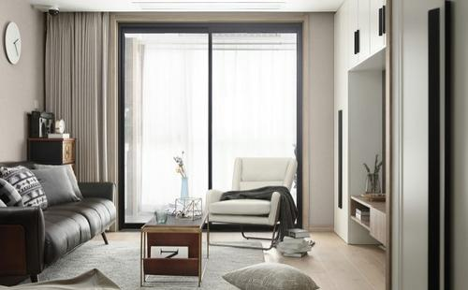
Scenario: Home

Slide 7
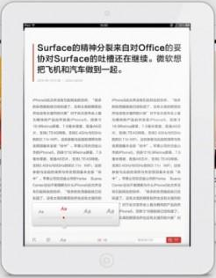
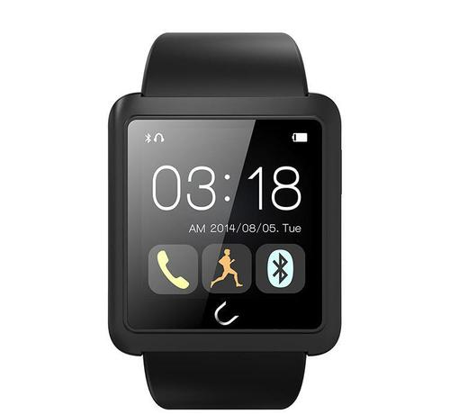
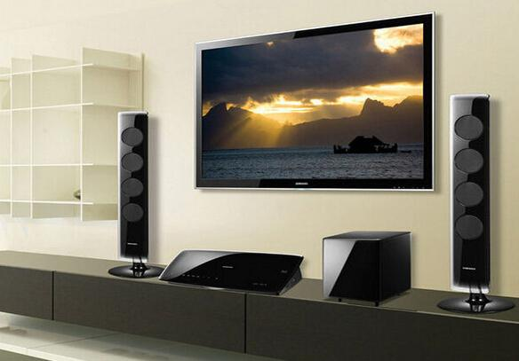
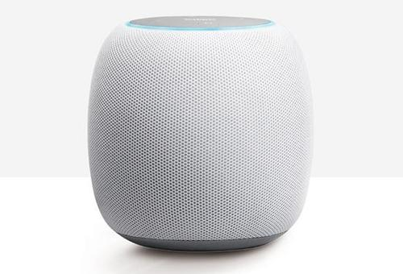
Devices
Smartphone/Smartwatch
Pad/PC/Smart TV
Bluetooth Speaker/earphones
Functions
Basic functions
News-related functions
Location-based Follow-up News-playing
Remote control
Input
Voice commands (the same as car scenario)
Through GUI on smartphone or smartwatch
Output
News with texts and pictures through smartphone/pad/PC
Video news through smartphone/pad/PC and smart TV
Audio news mainly through Bluetooth Speaker/earphones

Slide 8
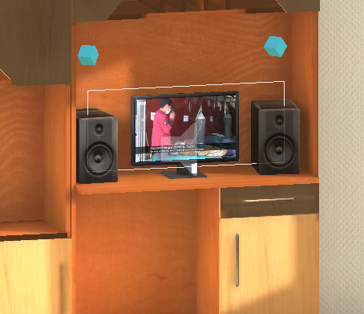
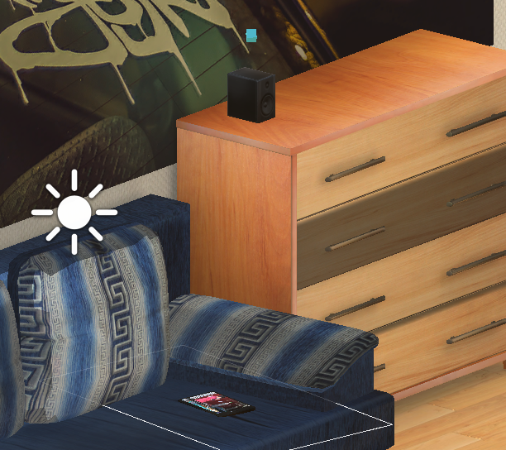
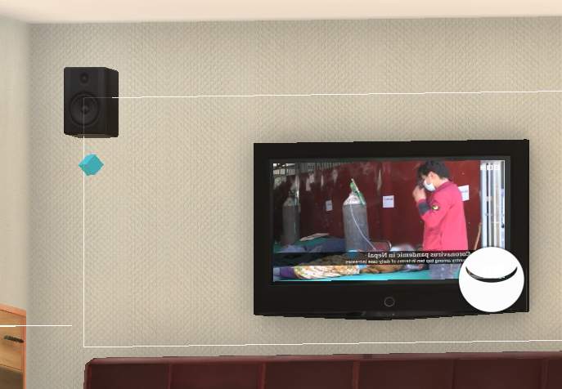
Location-based Follow-up News-playing
2
0
1
Notes:
In home scene, we usually have a variety of video sources like phone/pad/TV/PC and audio sources like stereos and the video sources themselves that distributed across the room. We want to make use of all of these video audio sources, to make the news listening and viewing experience more consistent and fluent.

Slide 9
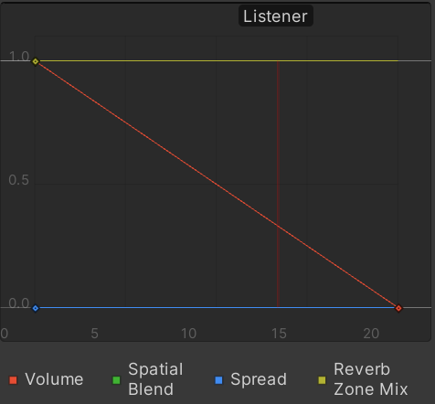
Implement
Transform of voice output between audio sources
Update the distances between the user (camera) and all the audio sources
Active the nearest audio source
Adjust the volume of the nearest audio source
Red line：linear rolloff function
Green line: audio source volume
Purple line: listener volume
Within 10m of each audio source, the actual
volume is consistent

Slide 10
Implement
Transform of visual output between video sources
Calculate the angle between the line from each video source to the camera and the forward direction of the camera (as a approximation of gaze direction)
Activate the video source if the angle is less than 60°
Human eyes have a angle of view of 126° in normal situations

Slide 11
Demo

Slide 12
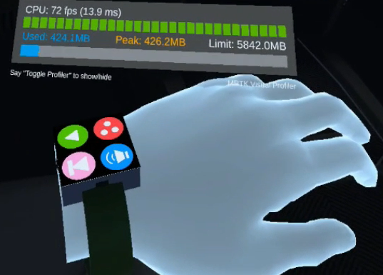
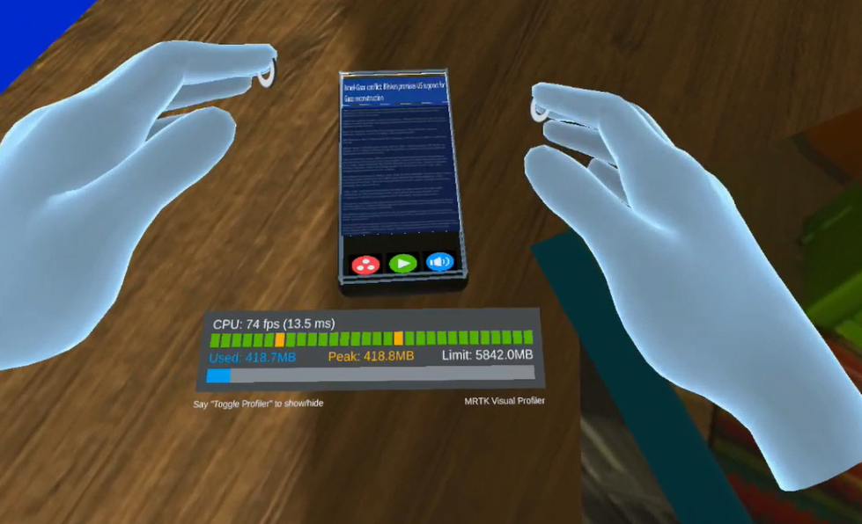
Remote control
Smartwatch
Smartphone

Slide 13
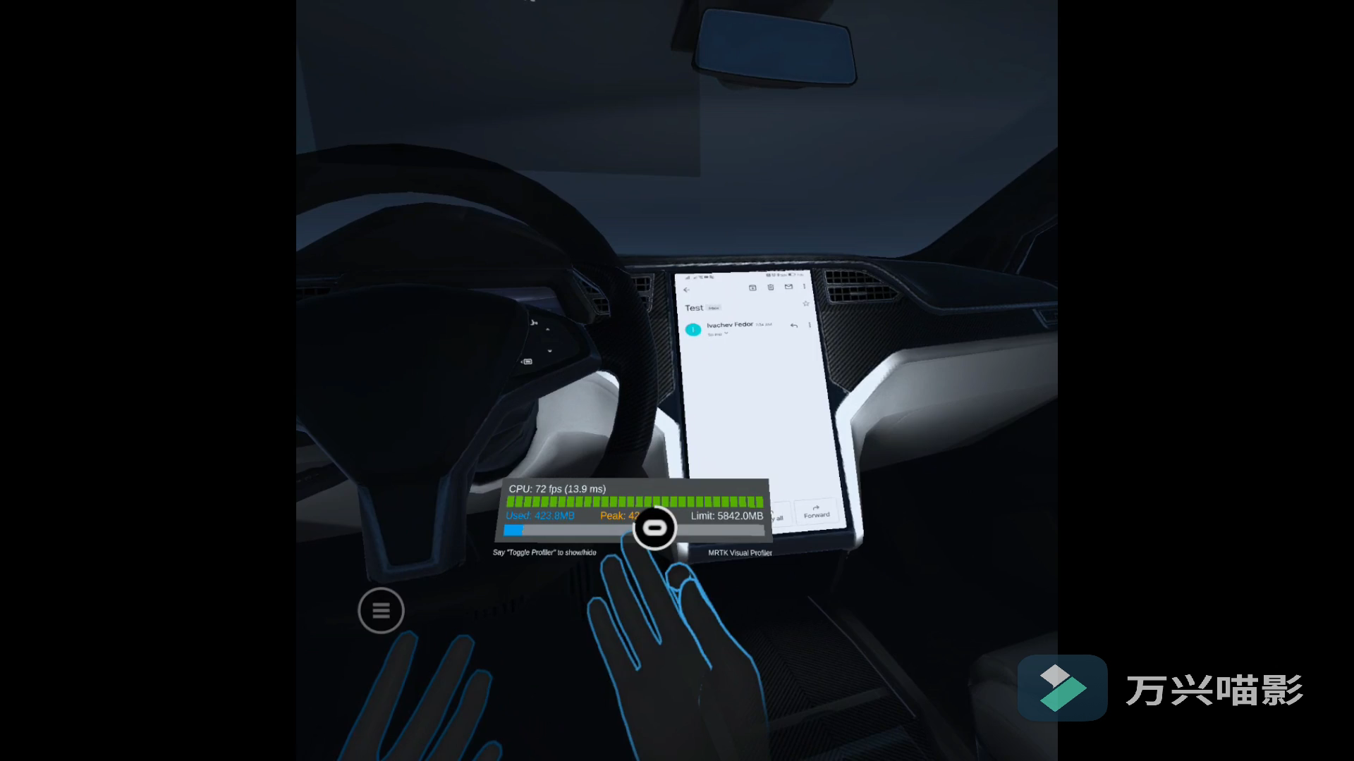
Remote control
Smartwatch
Smartphone

Slide 14
Remote control
Interactive UIs
Browing the news
Scrolling the screen
Choose news genre
Touchable button
Adjust volume
Grabbable slider

Slide 15
Remote control
Interactive UIs
Browing the news
Scrolling the screen
Choose news genre
Touchable button
Adjust volume
Grabbable slider

Slide 16
Remote control
Interactive UIs
Browing the news
Scrolling the screen
Choose news genre
Touchable button
Adjust volume
Grabbable slider

Slide 17
To Do
Increase the accuracy of gesture and eliminating uncontrolled vibration
Add some visual and auditory interaction feedback for the touchable button

